Slide 1

CAPSTONE PROJECT
The Team:
Kajal Jaiswal
Damini Tiwari
Ashwini Kumar
Anis Uddin
Mentor:
Sravan Malla
NLP CHATBOT

Slide 2
Presentation Overview
Problem Introduction
Exploratory Data Analysis
Data Preprocessing
Model Building
Chatbot Deployment

Slide 3
Summary of Problem Statement
Our AIML Capstone project is to design a ML/DL based chatbot utility which can help industry professionals to highlight the safety risks as per the incident description reported.
The database comes from one of the biggest industries in Brazil and in the world. It is an urgent need for industries/companies around the globe to understand why employees still suffer some injuries/accidents in plants.

Slide 4
Goals
Designing an AIML chatbot that recognizes the Accident Level, Potential Accident Level, Critical Risks involved with the accident based on the descriptions provided.
Designing and deploying a clickable UI based chatbot interface.

Slide 5
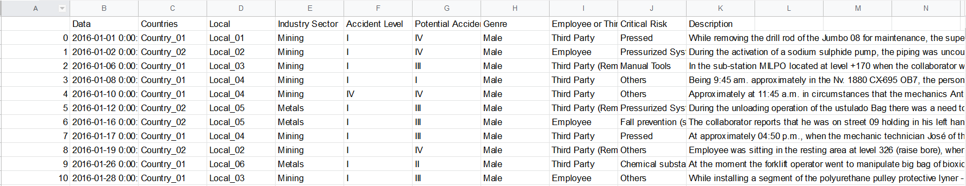
The Data

Slide 6
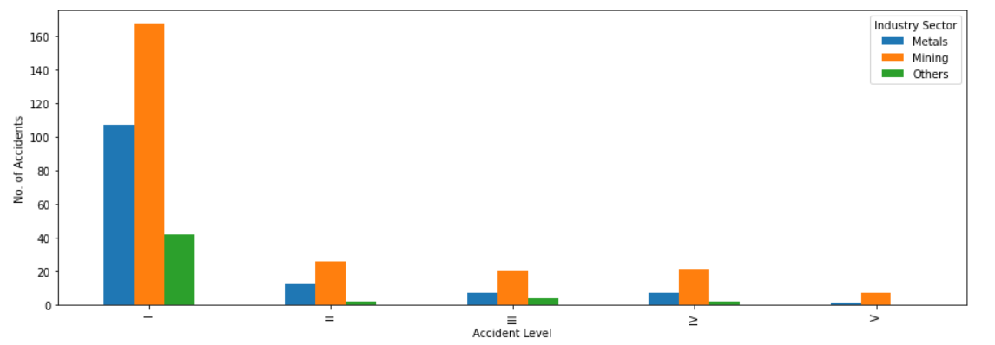
‘Accident’ count vs ‘Accident Level’

Slide 7
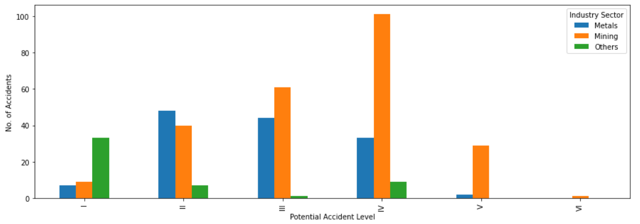
‘Accident’ count vs ‘Potential Accident Level’

Slide 8
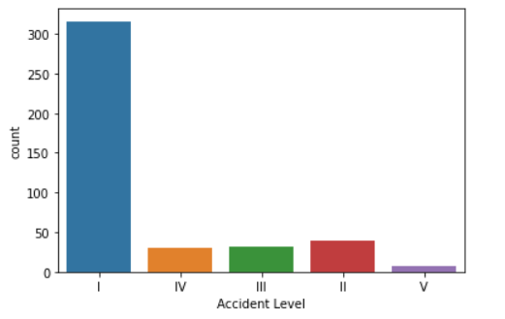
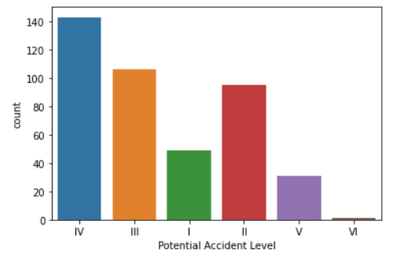
Count Plots for ‘Accident Level’ and ‘Potential Accident Level’

Slide 9
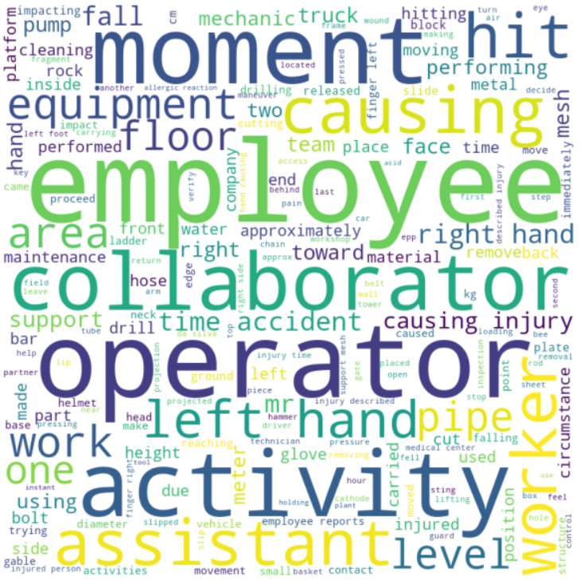
Word Cloud
The ‘Descriptions’ feature depicted as a word cloud.

Slide 10
Data Preprocessing
Eliminate any special characters
Remove Stopwords
Remove all punctuation
Lemmatization
Eliminating the 20 most rare words
Spellcheck
Tokenization
Sequence Padding

Slide 11
Before Preprocessing | After Preprocessing
data.Description[1] During the activation of a sodium sulphide pump, the piping was uncoupled and the sulfide solution was designed in the area to reach the maid. Immediately she made use of the emergency shower and was directed to the ambulatory doctor and later to the hospital. Note: of sulphide solution = 48 grams / liter. | data.Description[1] activation sodium sulphide pump piping uncoupled sulfide solution designed area reach maid immediately made use emergency shower directed ambulatory doctor later hospital note sulphide solution gram liter
data.Description[2] In the sub-station MILPO located at level +170 when the collaborator was doing the excavation work with a pick (hand tool), hitting a rock with the flat part of the beak, it bounces off hitting the steel tip of the safety shoe and then the metatarsal area of ​​the left foot of the collaborator causing the injury. | data.Description[2] sub station milo located level collaborator excavation work pick hand tool hitting rock part beak bounce hitting steel tip safety shoe metatarsal area left foot collaborator causing injury

Slide 12
Model Building
Below are the models that were used:
Logistic Regression
Random Forest
Support Vector Machine (SVM)
Ensemble Techniques : Boosting & Bagging
Neural Network
LSTM

Slide 13
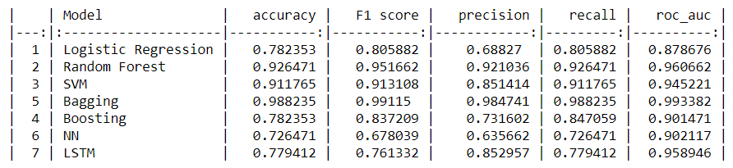
Training Metrics Accuracy Of AL

Slide 14
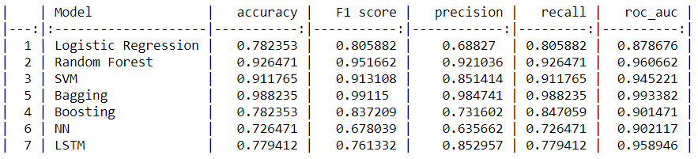
Testing Metrics Accuracy Of AL

Slide 15
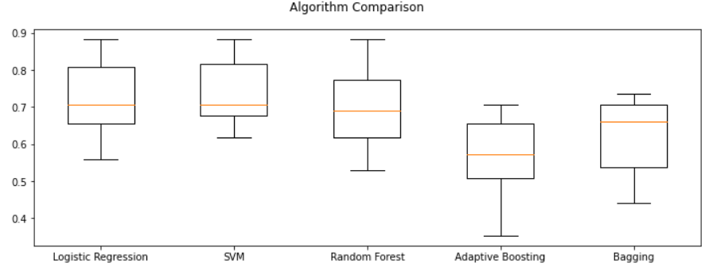
Cross Validation and ML models accuracy projection as box plot.

Slide 16
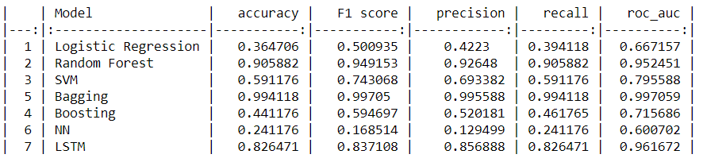
Training Metrics Accuracy Of PAL

Slide 17
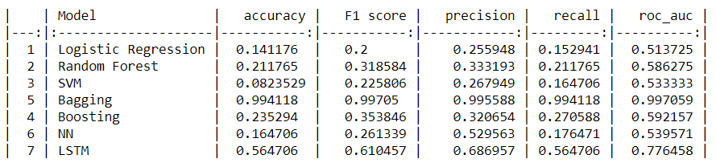
Test Metrics Accuracy Of PAL

Slide 18
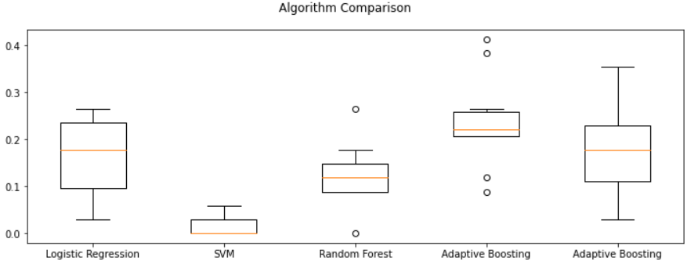
Cross Validation and ML models accuracy projection as box plot.

Slide 19
Model Selection
From the obtained results, we have selected the LSTM Model for this classification problem as it has shown all round performance in both test and train accuracies. The ML models have been observed to be performing great in train data and fairly poor in test data.

Slide 20
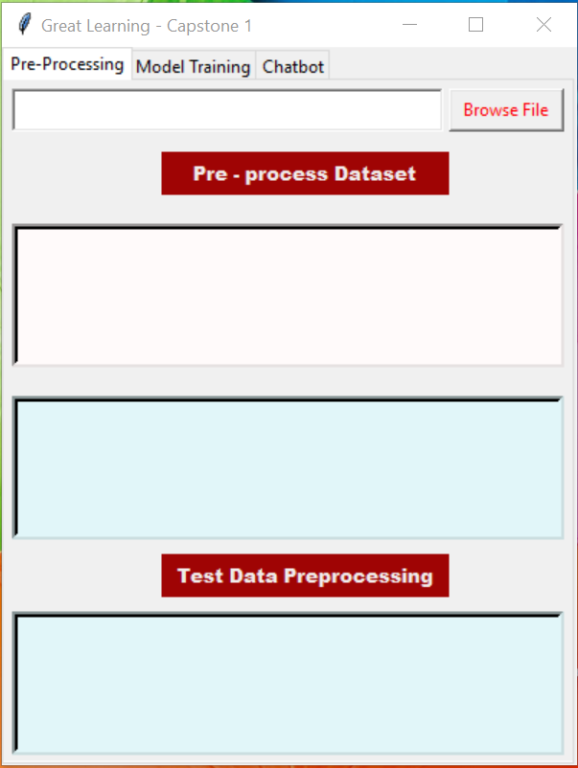
ChatBot Deployment
This is the Main Screen of the Chatbot UI along with the 3 buttons shown as tabs.

Slide 21
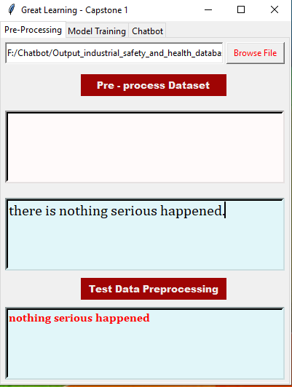
Initial Preprocessing
Here we are loading the dataset into the chatbot and running the preprocessing function to prepare an output file that can be used for making predictions later.

Slide 22
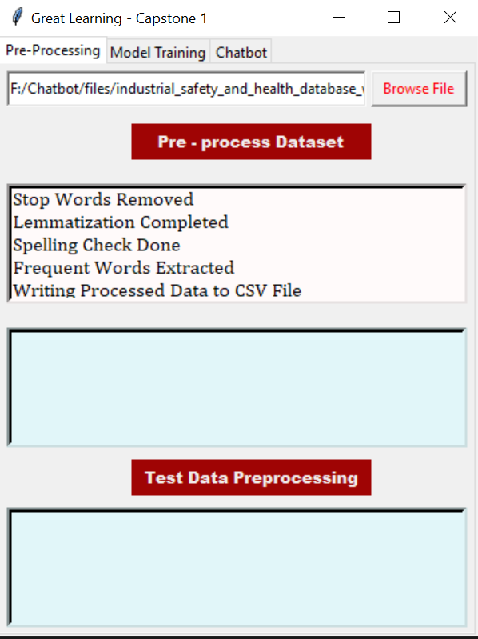
Here we are running the Preprocessing on the entire Dataset. It is showing the various functions that are being run in the background like removing StopWords, Lemmatization, Spell Check etc. The output is then saved as a CSV file

Slide 23
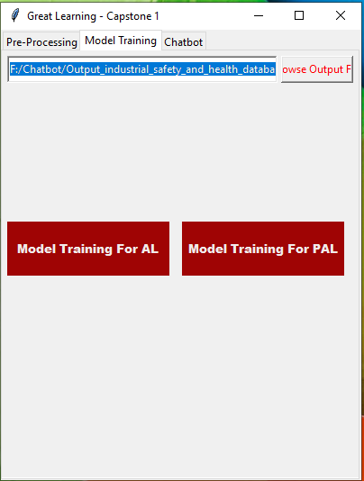
Model Training Button

Slide 24
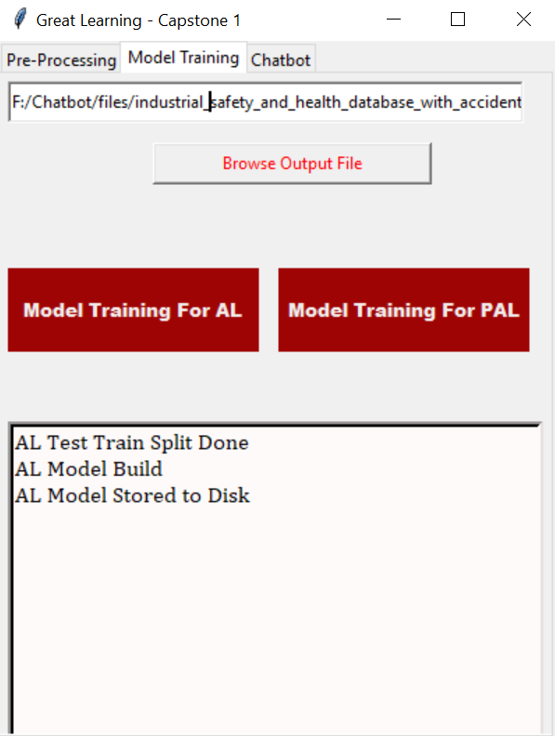
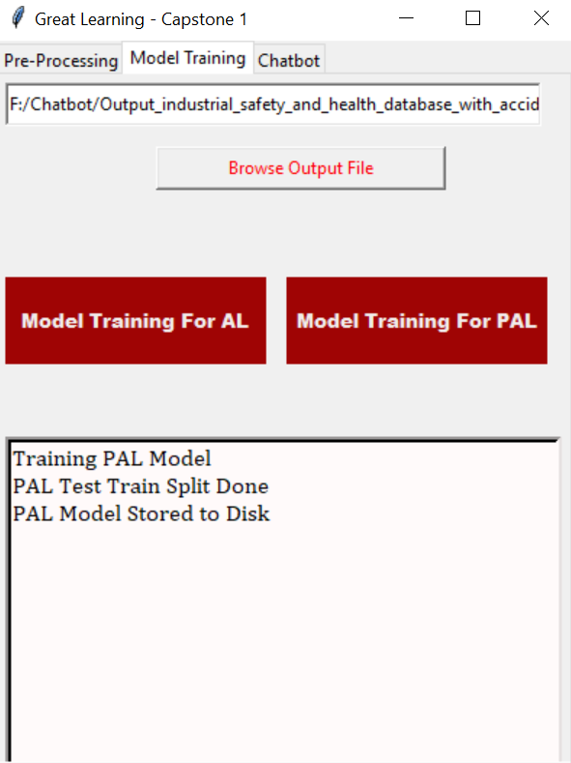
We can see the chatbot is performing the training on AL and PAL as well as splitting the data set and storing the model locally.

Slide 25
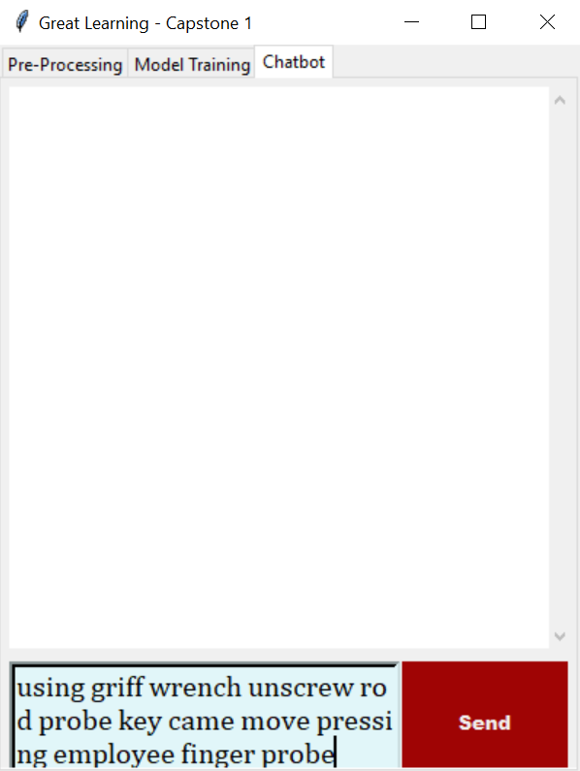
Finally, we are now typing out a description in the Chatbot button tab. This will be the input data for our models.

Slide 26
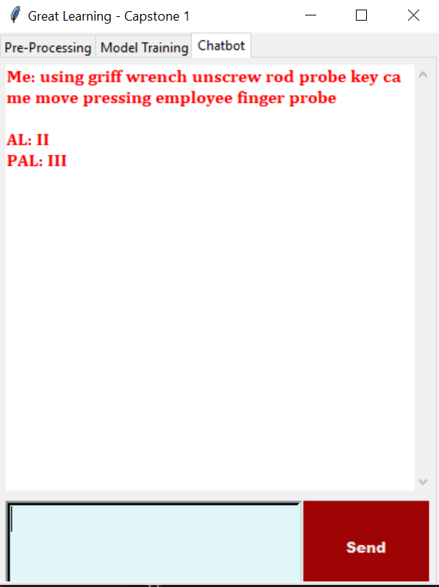
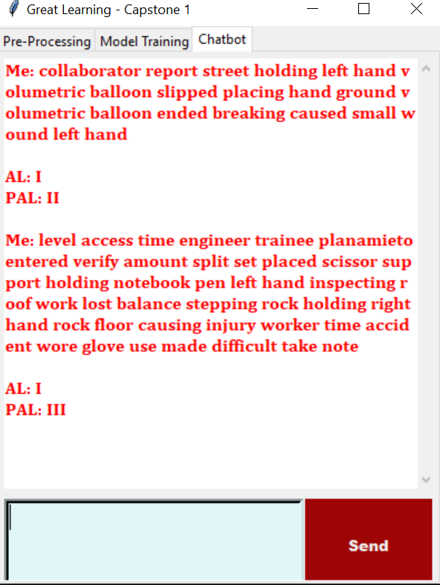
Here is the output of the chatbot where it is predicting the Accident level and Potential Accident Level based on the description of the accident.

Slide 27
Conclusion
We can conclude that we have successfully built a chatbot interface that can analyze a given text input and predict the required outcomes based on this.
Next steps of improvement to the project is discussed in the next slide.

Slide 28
Next Steps
Here are few points that were discussed within the team:
The chatbot can be made to be more human-like with some opening statements like ‘Welcome! I am your accident assistant. Please describe in details what has happened and I will help you to analyze the Accident Level as well as the Potential Accident Level’ and intermittent statements like ‘Please give me a moment, I am analyzing’ etc
There would need to be rules added to the Chatbot such as minimum length of input to be accepted so that a simple ‘Hi’ or ‘Hello’ is not considered as input. This would also eliminate poor predictions as a certain length of description is required for accuracy. In the case where this rule is not met, we can have an error statement such as ‘Sorry, I would need more detail to help you out. Please elaborate’
Hosting the GUI over a web based service for easier access as well as faster interactions as the training and testing data can be stored there itself and there wouldn’t be a need to run it over locally everytime.

Slide 29
Thank you
On behalf of the team, we wholeheartedly thank you for this wonderful opportunity to learn, experiment, implement and grow.

